Slide 1
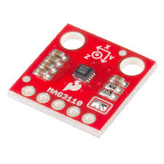
MAG3110 3-Axis Magnetometer
Presentation

Slide 2
PROPOSAL
Freescale's MAG3110 is a small, low-power, digital 3-axis magnetometer. The device can be used in conjunction with a 3-axis accelerometer to realize an orientation independent electronic compass that can provide accurate heading information.
The sensor will give the readings of the change in the x,y,z axis . Like when the sensor is brought near to any electromagnetic substance, the calibration of the all the axis of the sensor changes . Multiple objects in a particular device such as smart phone, laptop .It can also be used as a geo tracker or any tracker to give the accurate data .Which I along with my group members Anshul and Simarjeet are planning to do in next semester .

Slide 3
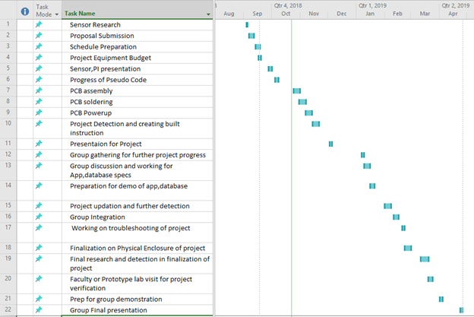
Schedule
Everything went properly as planned I was able to complete all the requirements for project in time.

Slide 4
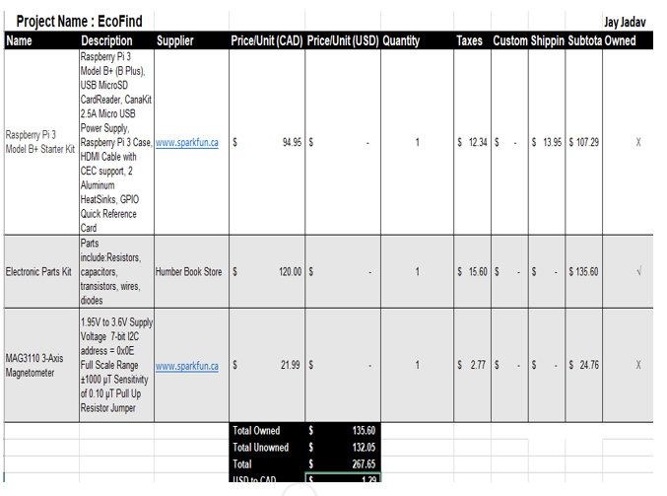
Budget
The budget for my project has stayed to the point .
TMP102 SENSOR :- $ 24.76
RASPBERRY PI :- $107.29
HEADER PINS GOT FROM PROTOTYPE LAB.
TOTAL EXPENSE :-$132.05

Slide 5
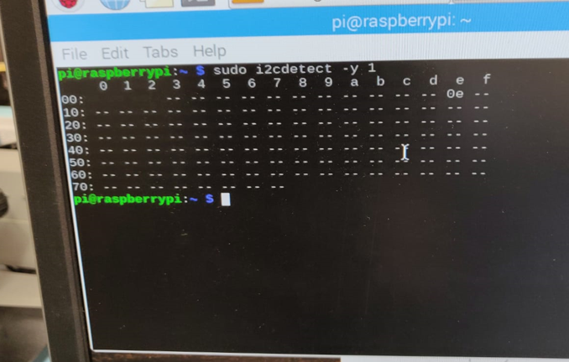
Address Detection

Slide 6
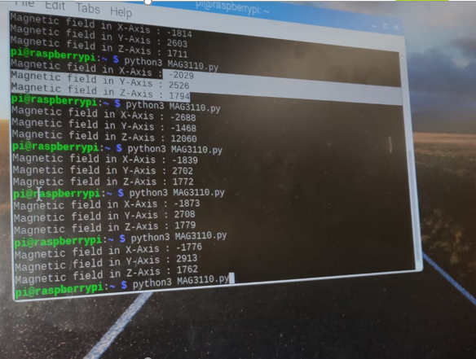
Reading From the sensor

Slide 7
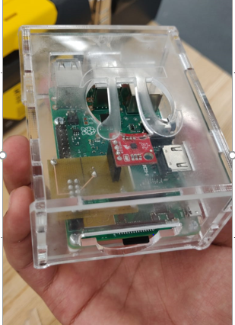
Enclosure

Slide 8
Course Knowledge
TECH 153 and CENG209 :- Learnt about the raspberry pi and its working.
TECH 101 and TECH150 :- Learnt about how to work with electronic circuits.
CENG 216:- Learnt about Gantt Project and assisted with documents.
CENG217- Assisted with learning Python.
ESOL 120 and 220 :- Learnt about documentation, how to write reports and to email .

Slide 9
Thank you !

